Slide 1
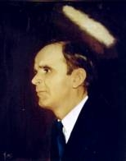
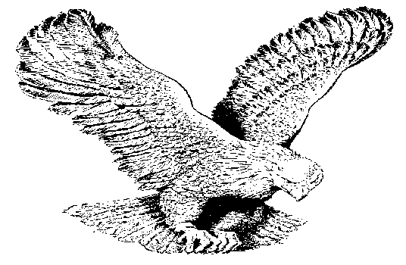
114
I CAN, I WILL, I DO BELIEVE
I can, I will, I do believe;
I can, I will, I do believe;
I can, I will, I do believe
That Jesus heals me now.
(I’m trusting only in the Lord…)

